Slide 1
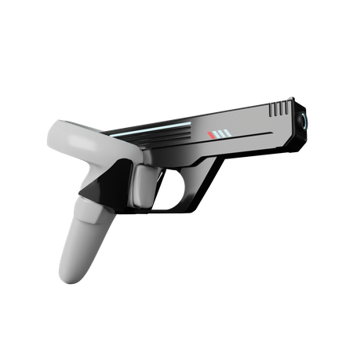
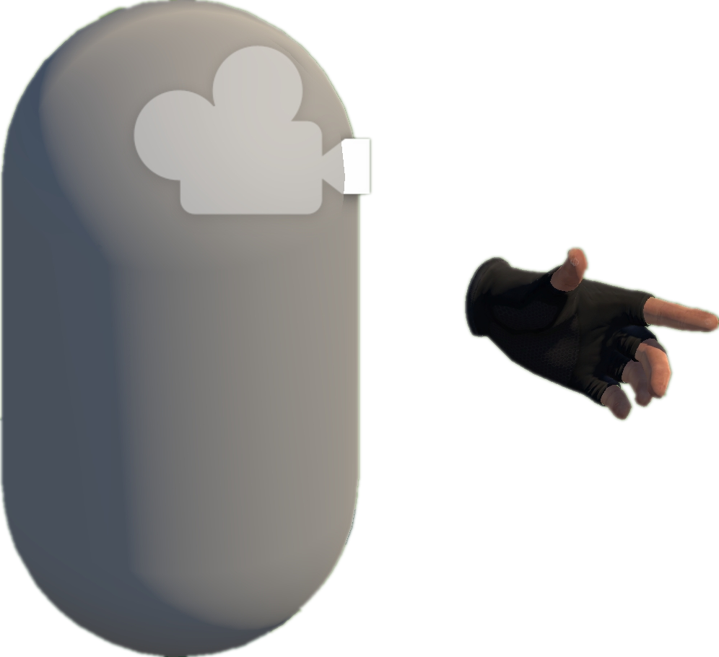
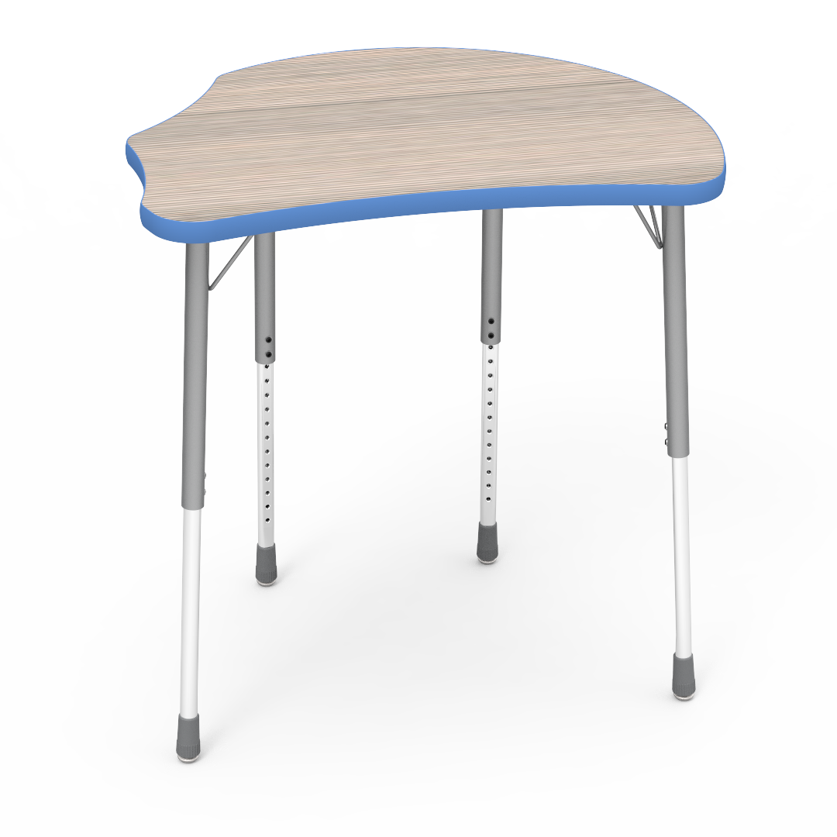
Move to Approach The Gun
1
Try to Grab the Gun
2
Move Around Randomly; Try to Fire the Gun
3

